Slide 1

Data Visualization and Communication Project I: Dementia Deaths Greece v. Europe Part I: Static Plots
Eirini Mylona

Slide 2
Introduction
The purpose of this project was to study the existence of an increasing trend in the dementia deaths of Greece or whether the behavior of Greece is different than the rest of the Europe. We are given a dataset with the dementia deaths per European country for the years 2011 – 2021, by gender. Since our interest is based only on the years 2011 – 2020, we decided to exclude the year 2021 from our data. During the preprocessing phase, it was observed that some of the European countries had missing values for some years. Hence, we decided to drop these countries altogether. Since some of the countries have been excluded, EU28 and EU27_2020 are excluded too. To replace them, we created a new variable EU27 which contains the sum of the 27 remaining countries except Greece, since Greece is the main target of our research. Our final dataset contains 28 countries, Greece included.
Moreover, our research was not based solely on the dataset we were given since the dementia deaths of a country is not a standalone metric for comparison due to the fact that each country does not have the same number of total deaths per year. Thus, the dataset of the total deaths per country is added to our dataset. Additionally, in the first part, we split the dementia deaths in two age groups (Under & Over 65) both for males and females while in the second part we concentrated in three age groups of over 65. It is appropriate to be mentioned the fact that the comparisons of Greece with the other European countries have been conducted under the death rate of dementia deaths divided with the total deaths of each country and then multiplied by 100,000. This ratio indicates the number of dementia deaths per 100k deaths of each country.

Slide 3
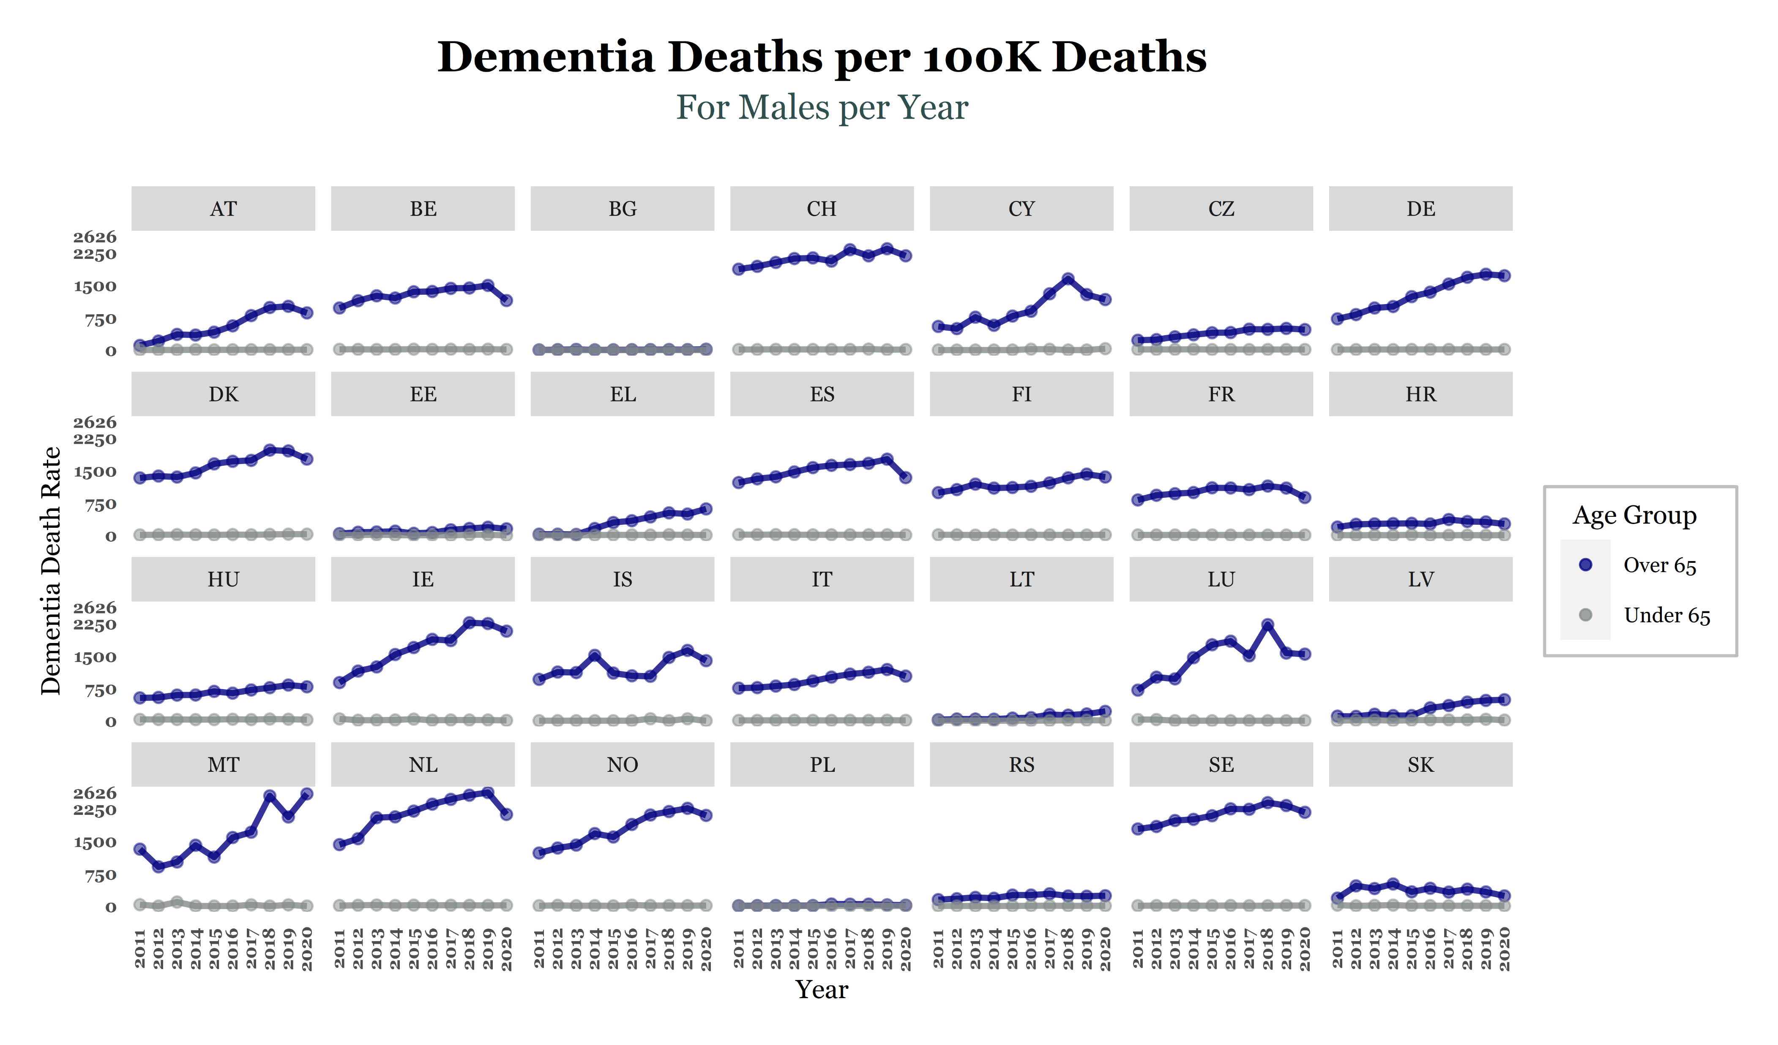
Trellis Plot for Males (Line Plot)
We start our analysis by creating a trellis plot of trend lines of each European country for the dementia death rate for males over and under 65 for the years 2011 – 2020. Firstly, it is observed that generally for the majority of the European countries the dementia death rate for males under 65 is extremely low (almost 0). Hence, our interest is based only to those who are over 65. The trend line of Greece, seems to increase over the years, whereas other European countries with similar behavior with it seem to be the Czech Republic (CZ), Hungary (HU), Latvia (LV). We observe that Bulgaria’s (BG) and Poland’s (PL) death rate both for the two age groups is extremely low.

Slide 4
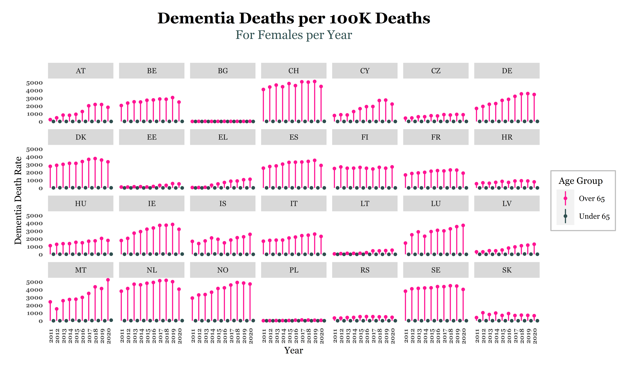
Trellis Plot for Females (Lollipop Plot)
We proceed by creating a trellis plot of lollipop lines of each European country for the dementia death rate for females over and under 65 for the years 2011 – 2020. Firstly, it is observed that generally for the majority of the European countries the dementia death rate for females under 65 is extremely low (almost 0). Hence, our interest is based only to those who are over 65. Concerning Greece, there is an increasing trend over the years, whereas other European countries with similar behavior with it seem to be the Czech Republic (CZ), Croatia (HR) and Latvia (LV). We observe that Bulgaria’s (BG) and Poland’s (PL) death rate for both age groups is almost 0. From now and then we only use the age group over 65 for our analysis.

Slide 5
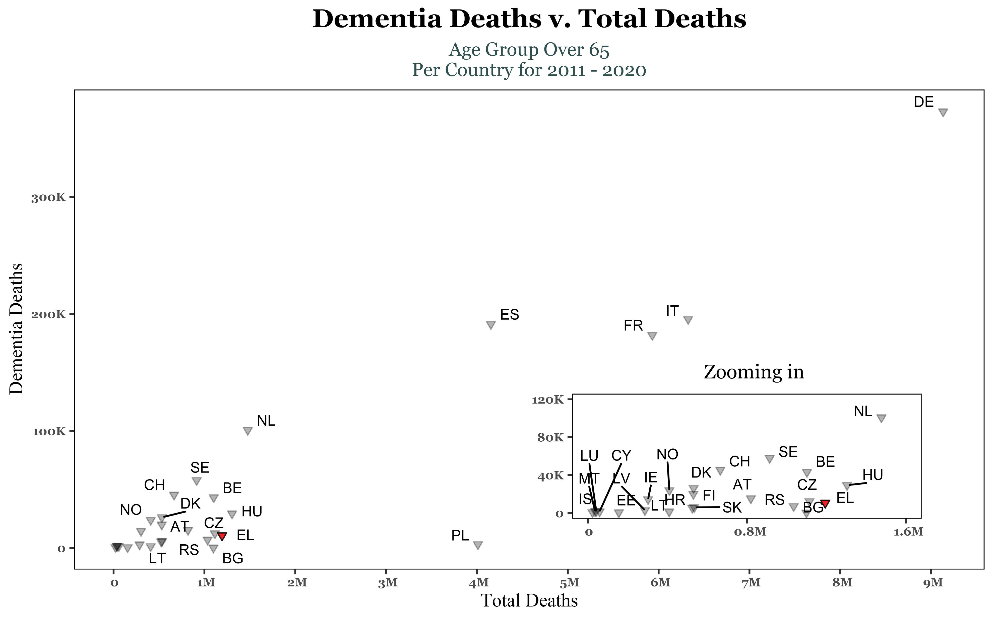
Scatter Plot
Having reached to the conclusion that there is no need to keep the age group under 65, since dementia deaths both for males and females are almost zero, we proceed by creating a scatter plot for the total number of males and females (Total) over 65 for each country for the years between 2011 - 2020.
Generally, this specific scatter plot depicts that as the number of total deaths increases, dementia deaths increase too. Thus, there is a positive correlation between the dementia deaths and the total number of deaths. Concerning Greece, we observe that in comparison with other countries with similar number of total deaths (ex. BE, HU), its dementia deaths ranges at low levels.

Slide 6
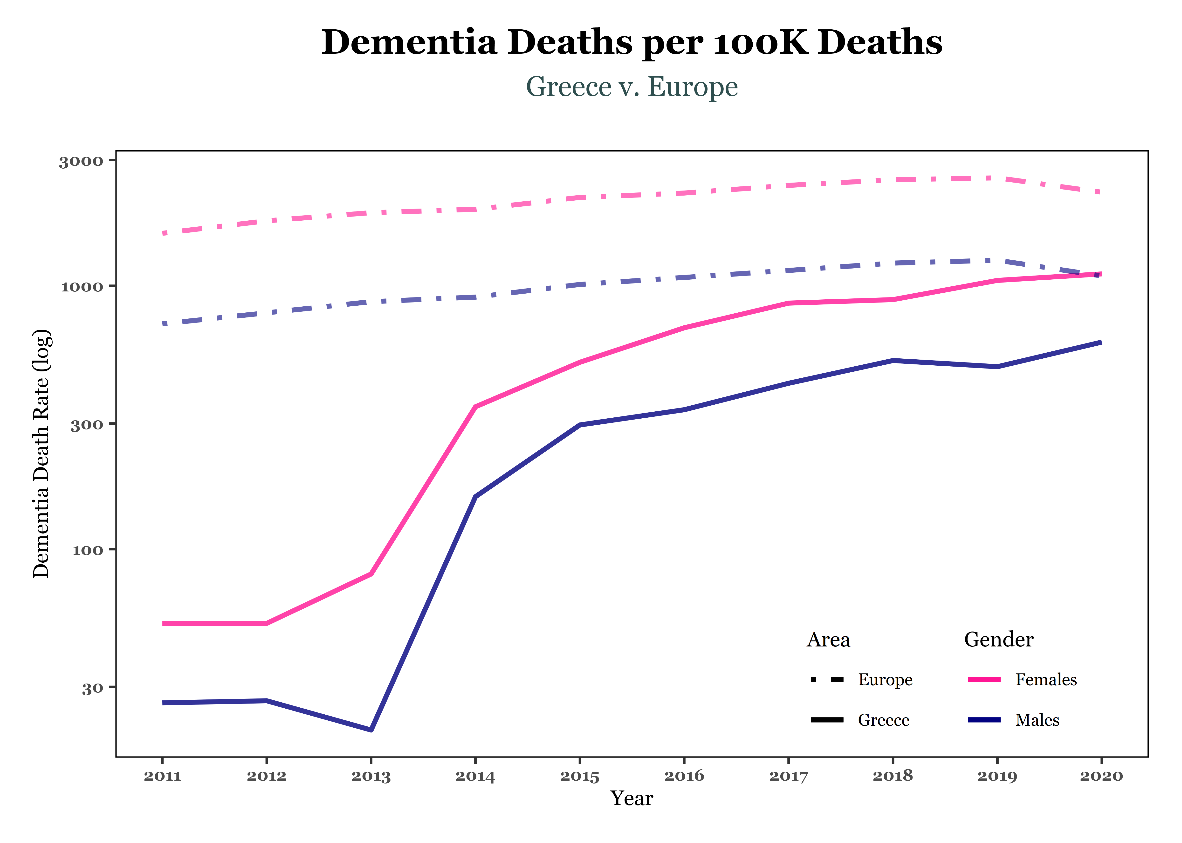
Line Plot
This plot depicts the log(dementia death rate) over the years both for Greece and for Europe. Europe contains the dementia deaths rate of the EU27 variable. The log scaling of axis y is adopted in order the lines to be clearly separable.
From the plot, we observe that Greece’s dementia death rate is under Europe’s for both genders. Furthermore, females appear to be more vulnerable to be affected by the disease of dementia and more likely to die from it than males both for Greece and the rest of the Europe.

Slide 7
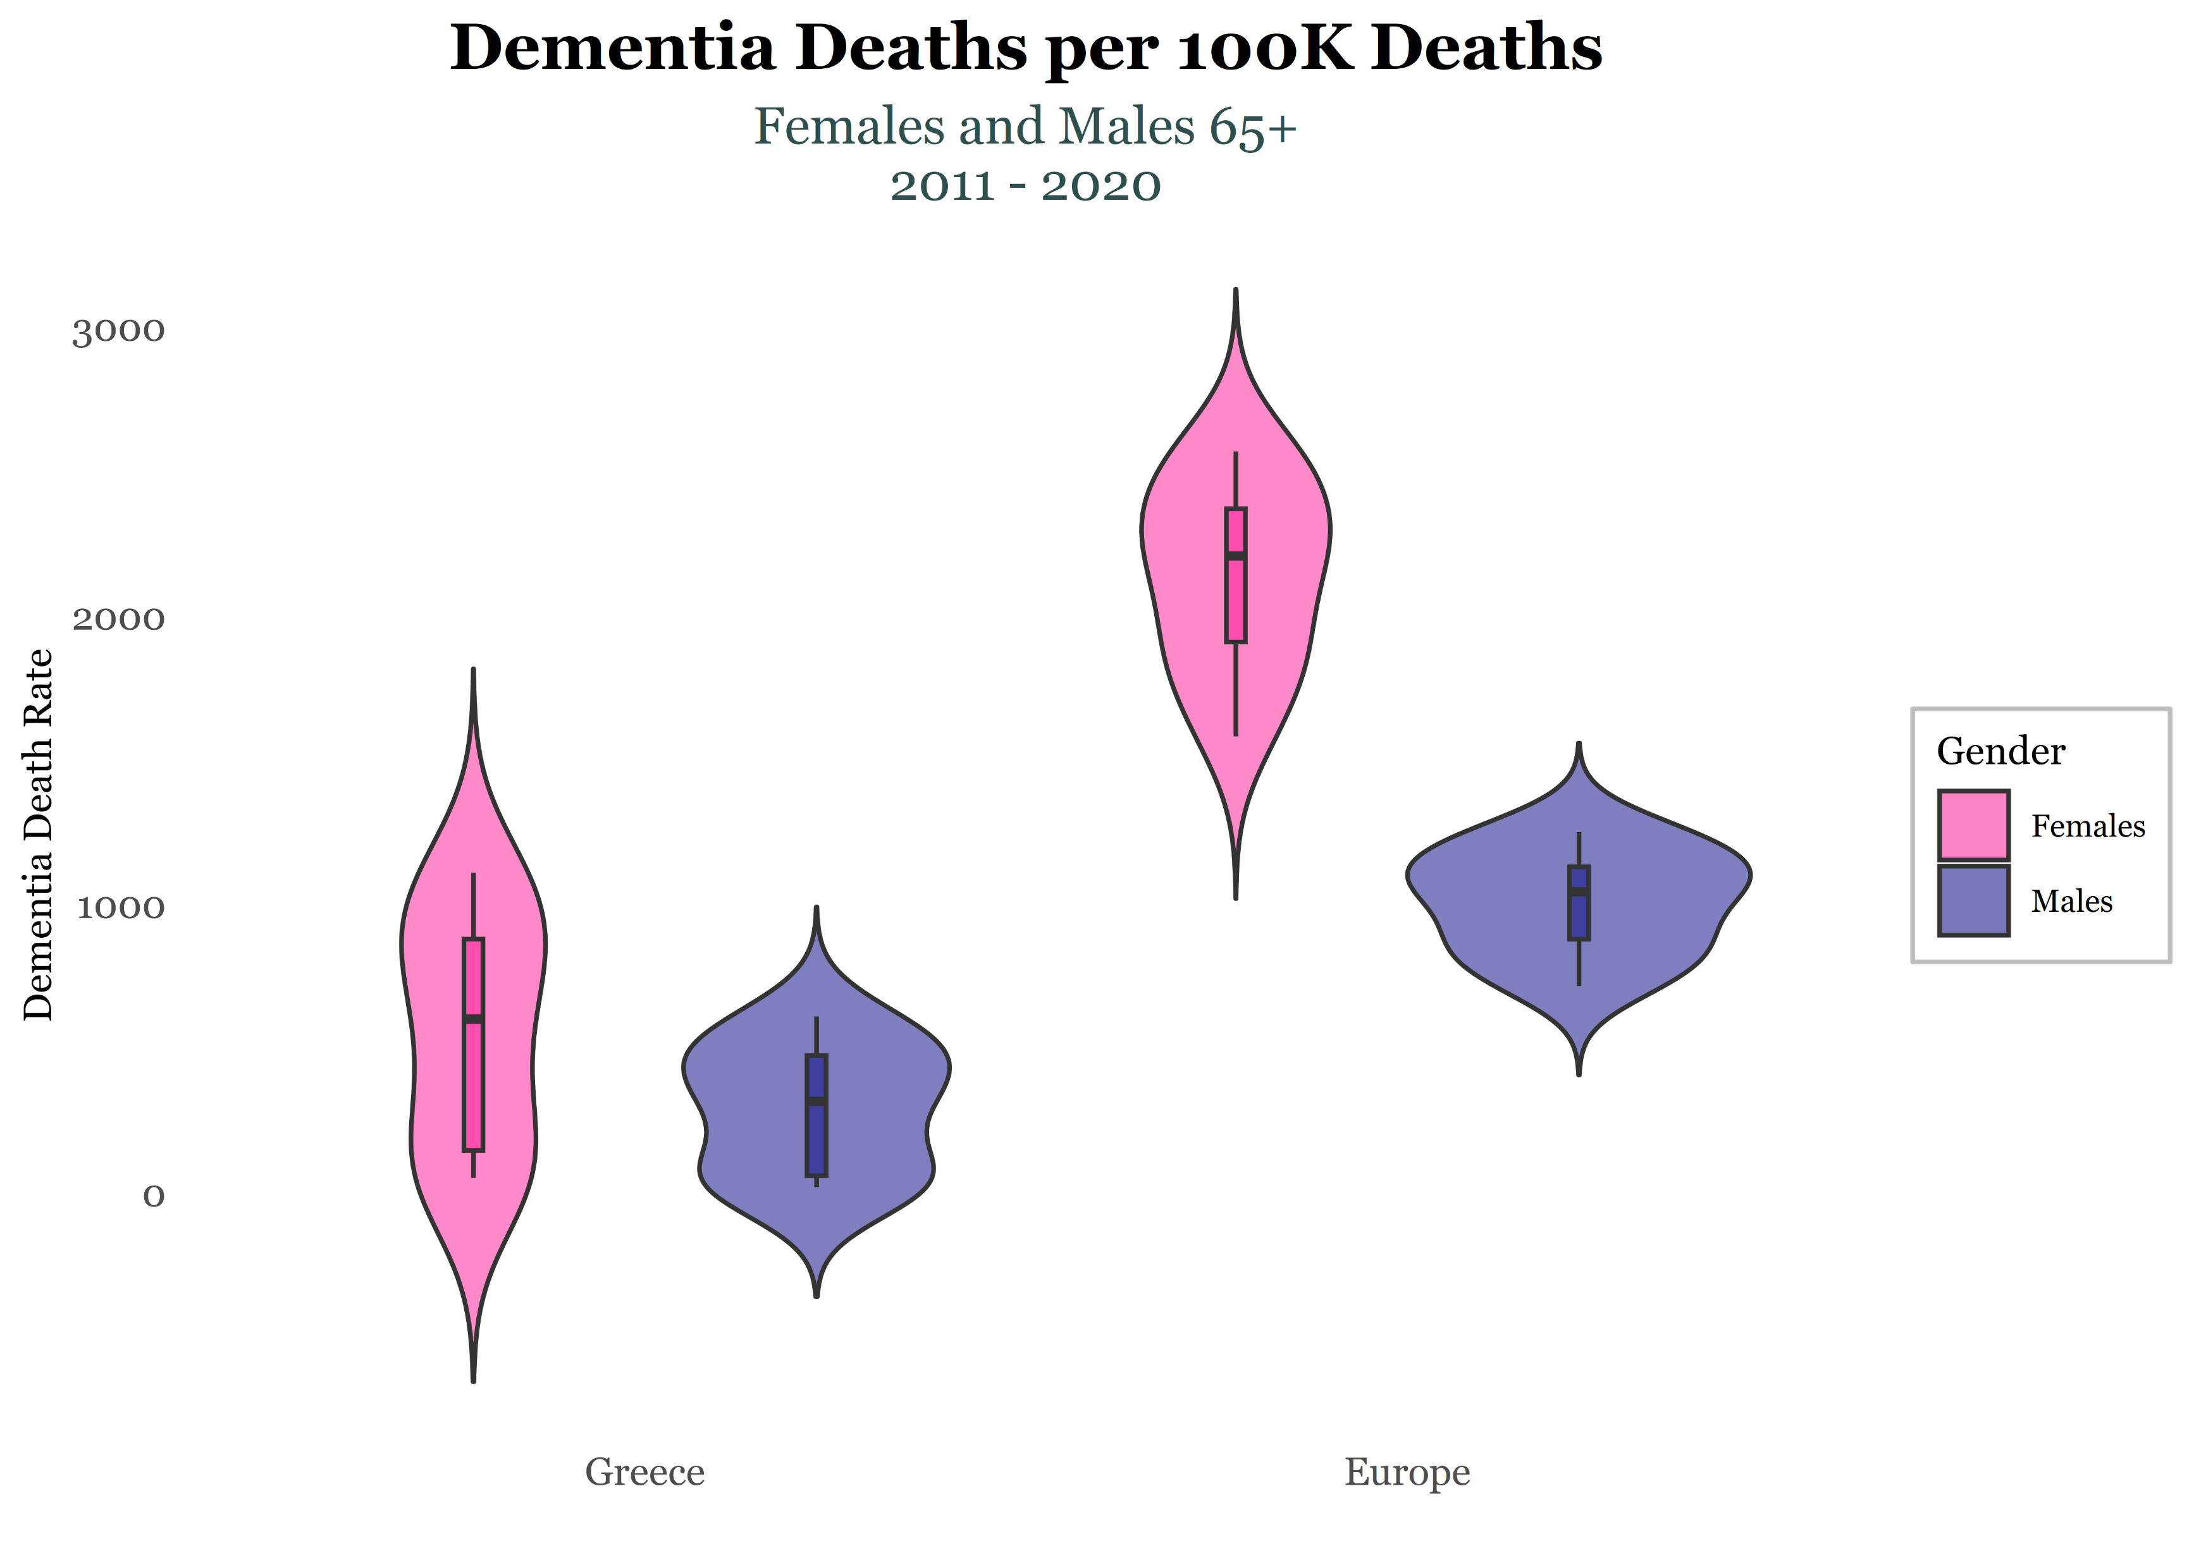
Violin Plot
From the violin plot, it follows that Greece’s median of dementia death rate is lower than Europe’s for both genders. Furthermore, as revealed by the previous diagram, females are more likely to die from dementia compared to males.
Concerning the distribution of our data, it seems that every distribution is bimodal. Greece’s distribution for females seems to be more symmetric when compared with the one of Europe’s. Similar conclusions arise from both male distributions.

Slide 8
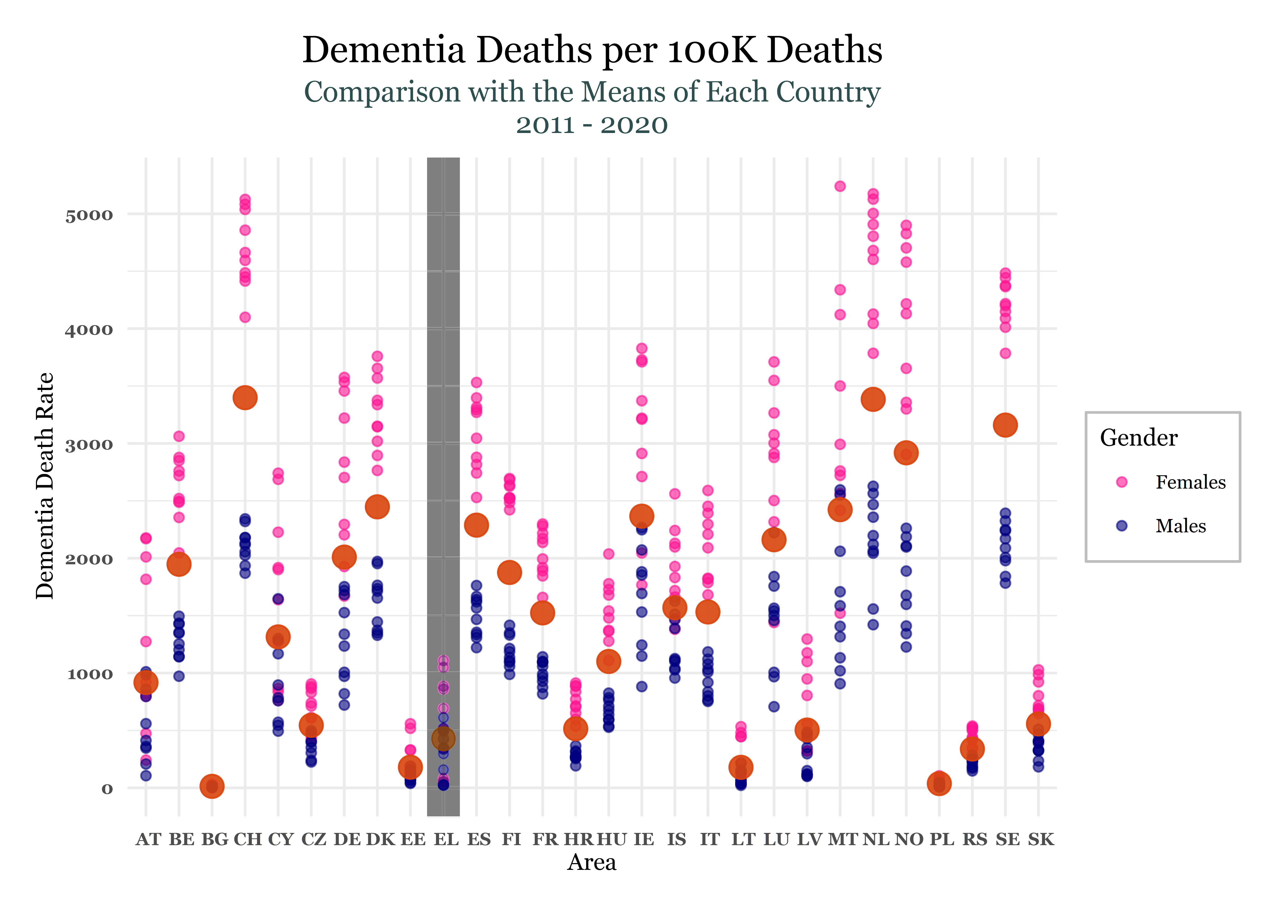
Point Plot
The red point in this graph, refers to the mean of the dementia death rate (per 100k deaths) of each country for the years 2011 – 2020. Each point of the respective country is the dementia death rate for every year and gender separately.
From this graph, it follows that in every European country, Greece included, female dementia death rate per year is over the mean of the respective country. Hence, we reach to similar conclusions to the previous plots that females are more likely to die from dementia than males. Additionally, Greece’s mean ranges in low levels in comparison with the other European countries whereas the Czech Republic (CZ), Hungary (HU), Latvia (LV) and Slovakia (SK) seem to have similar behavior with it concerning the mean of the dementia death rate.

Slide 9
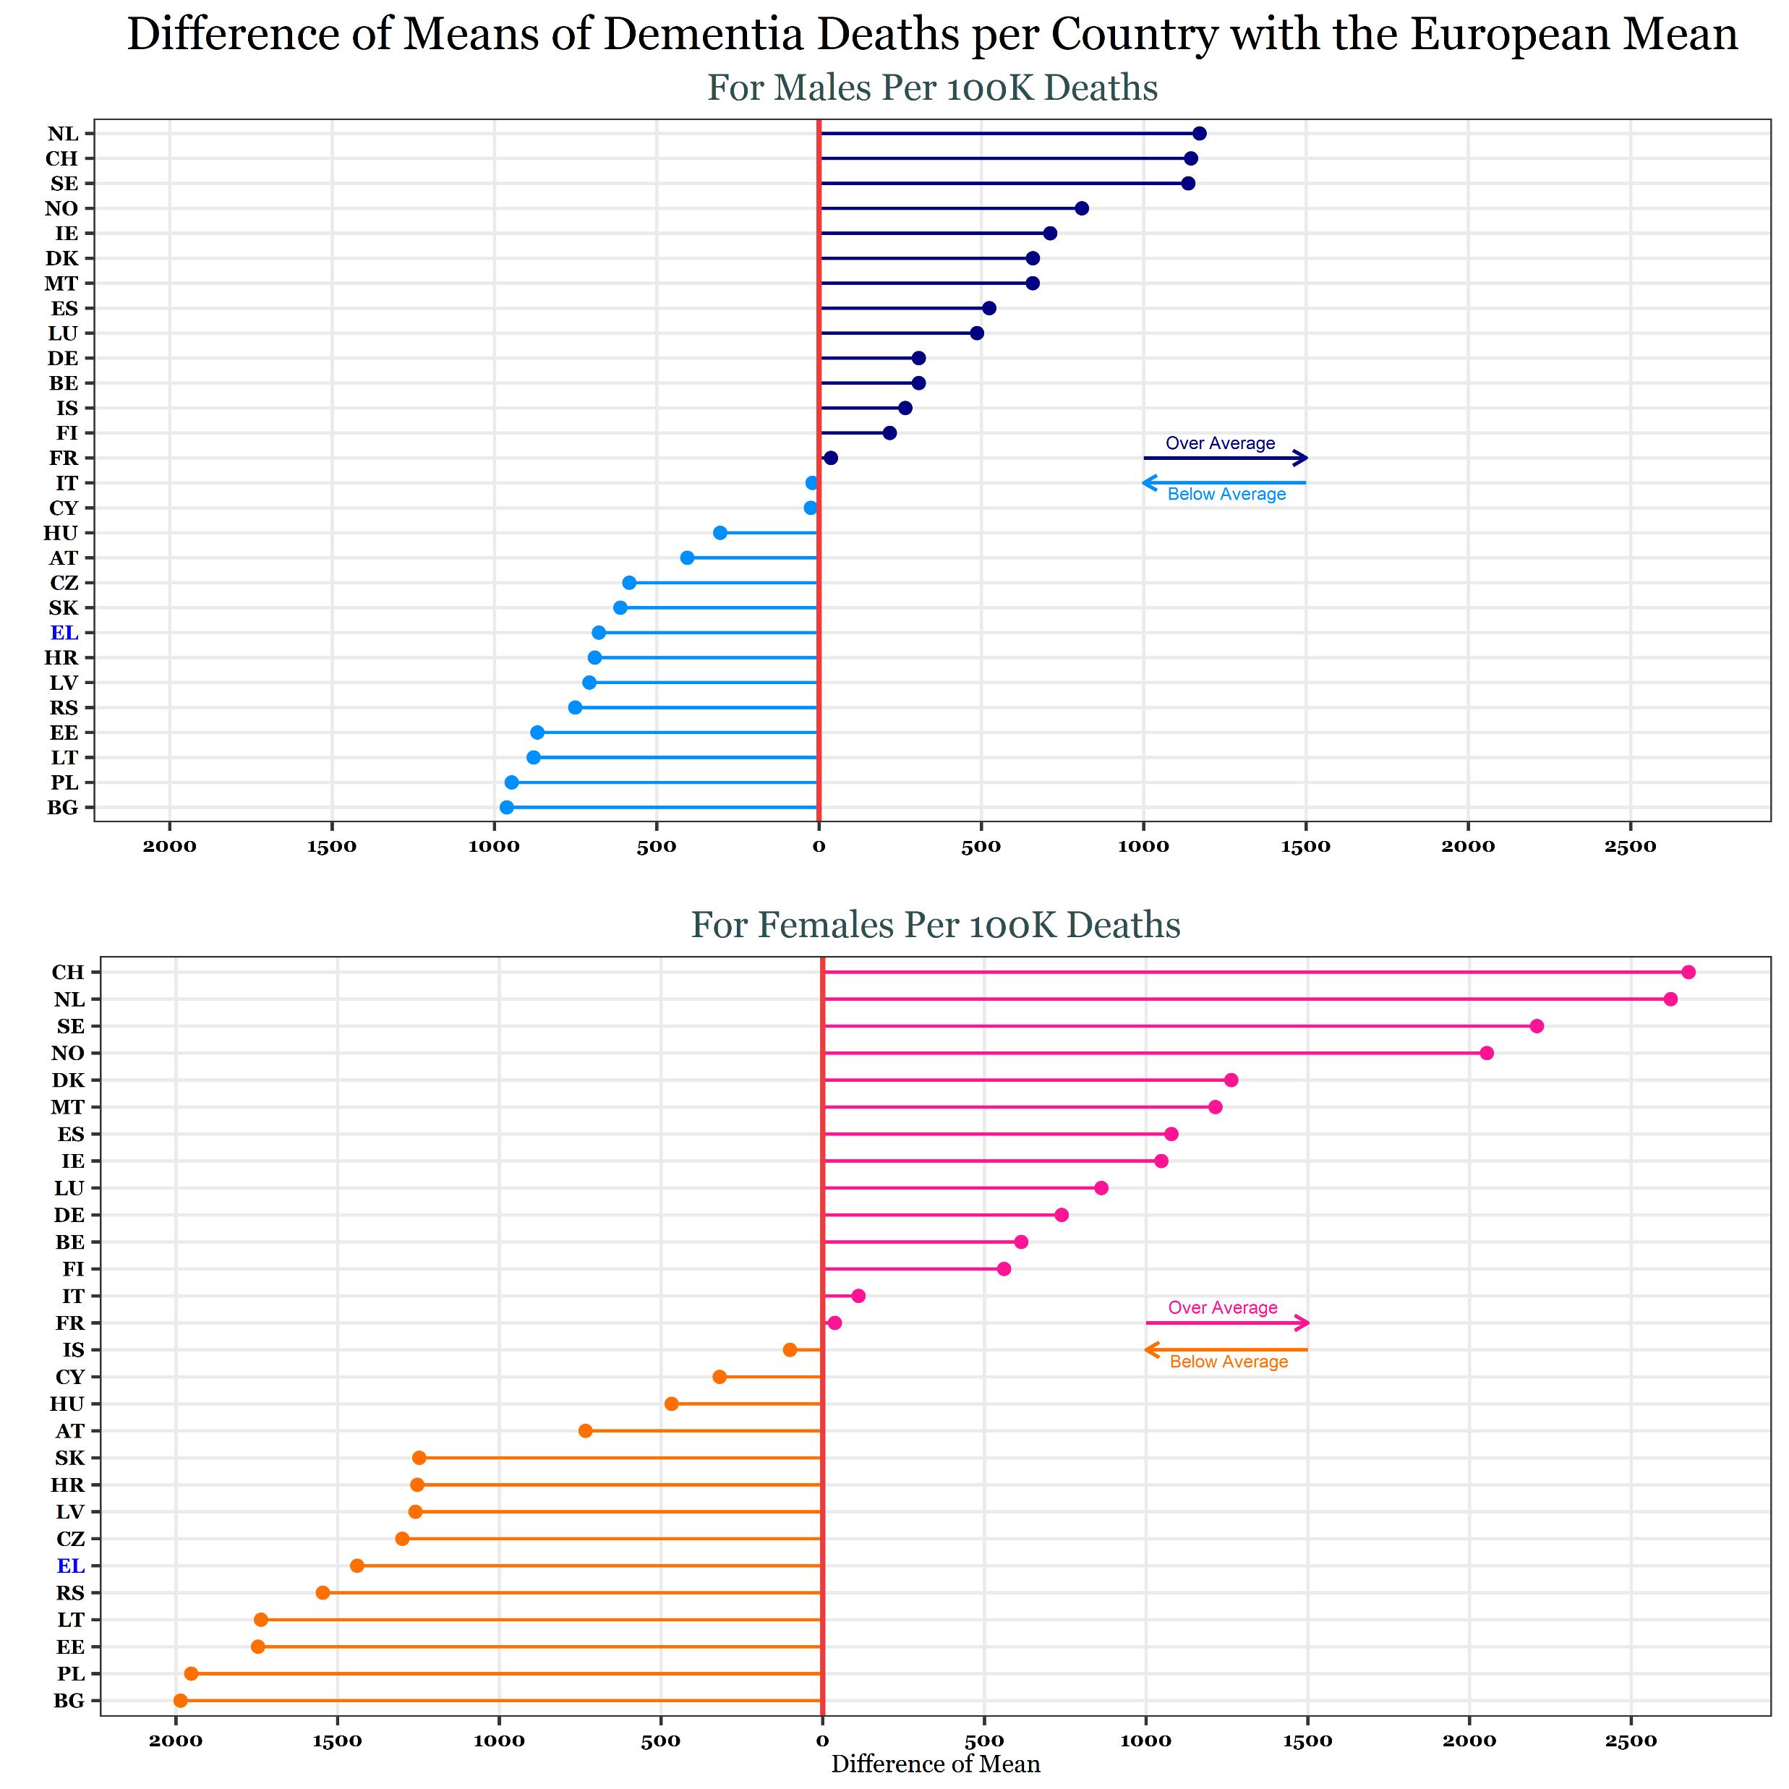
Lollipop Plot
In order to create the lollipop plot, we computed the difference of means of each country from the European mean, of the last decade, separately for the two genders.
As it follows from the diagram, the difference of means between the Greek and European means is below the European mean, both for males and females. Once again, it arises that females are more likely to die from dementia than males since the difference of each country of the European mean seem to be higher than the one of males, which holds true both for Greece and the rest of the European countries.

Slide 10
Exploration of the age subgroups 65+
As we mentioned before, both males and females under the age of 65 have low dementia death rates. Hence our interest turned on to those aged over 65. From now on, we will present plots concerning only the following age groups over 65.
65 – 74
75 – 84
85+

Slide 11
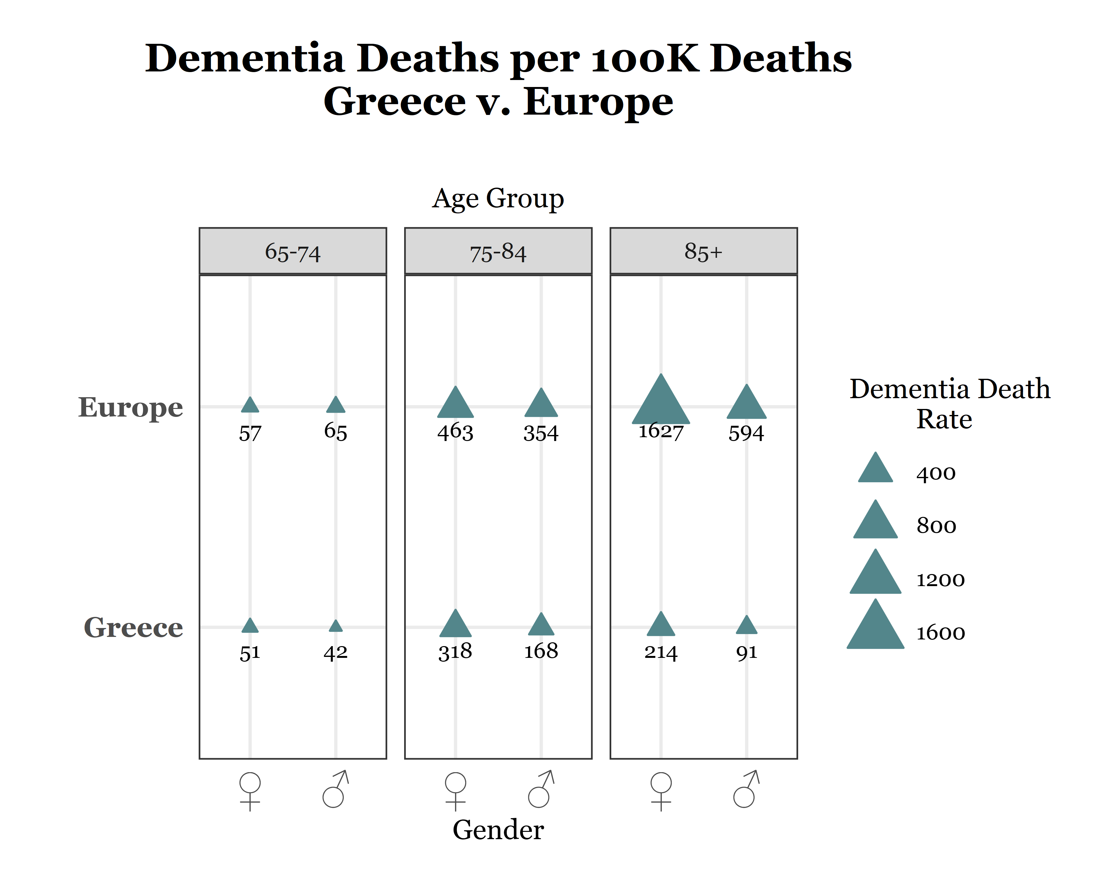
Balloon Plot
The balloon plot on the right, concerns the dementia deaths per 100K deaths for Greece and the rest of Europe, for different age subgroups over 65 for males and females. The size of each triangle indicates the ratio of dementia deaths to total deaths per 100K deaths. For easier comparison, the absolute number of this is also shown.
The graph shows that Greece has a lower dementia death rate compared to the rest of Europe for all groups. Additionally, it is evident that females are more affected than males, both in Greece and in Europe. Moreover, it is apparent that the age group 75 - 84 is more affected than any other age group in Greece, while the corresponding age group in Europe is the 85+.

Slide 12
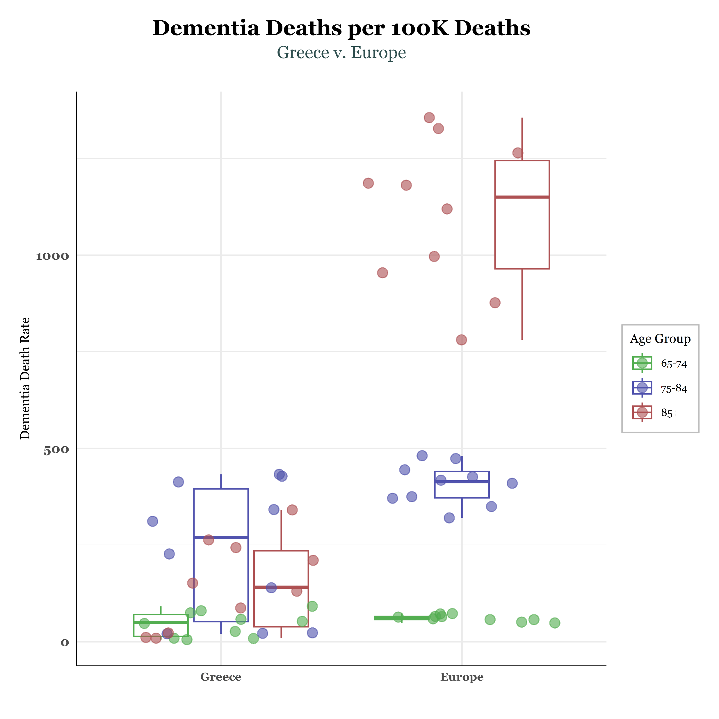
Boxplot
In this boxplot, we compare the total deaths from dementia per 100K deaths between Greece and Europe for all age groups for the years 2011-2020. We observe that in Greece, the age group that appears to be more affected is the 75-84, as its median differs significantly from the median of the other age groups.
Additionally, we notice that the median of Greece is lower than the median of Europe for all age groups.
Furthermore, it is evident that the observations concerning Greece are more dispersed in space compared to Europe, where they are distributed around the corresponding boxplot.

Slide 13
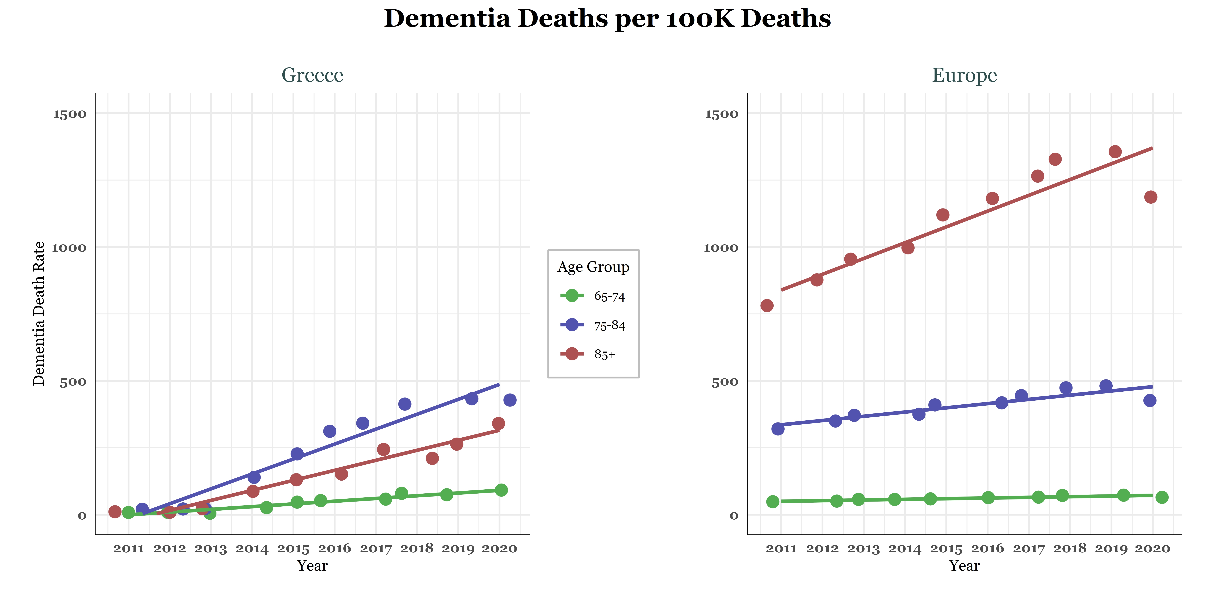
Scatter Plot with Fitted Lines
In this diagram, the x-axis represents the time period we are studying, namely 2011-2020, while the y-axis represents deaths from dementia per 100K deaths. Both in Greece and the rest of Europe, it appears that the number of deaths from dementia per 100K deaths increases linearly over time.
Additionally, it is evident that the age group 75-84 in Greece is more affected than the other age groups, while in the rest of Europe, the age group 85+ is more affected. Finally, we observe that the age group 65-74 in Greece records a slightly higher number of deaths from dementia over time compared to the rest of Europe.

Slide 14
Conclusions
Our analysis has yielded the following conclusions:
The percentage of people under the age of 65 affected by dementia is very low, which is why we focused on age groups above 65.
Women have a higher likelihood of being affected by and die from dementia compared to men.
Regarding Greece compared to other European countries:
The average death rate from dementia for both women and men is below the European average.
There is a significant upward trend in dementia-related deaths for both genders over time, which may be attributed to increased reporting of dementia-related deaths over the years.
The age group most affected in Greece is 75-84, whereas in the rest of Europe, it is the 85+ age group.

